Slide 1
Legal Aid in India: Issues & Challenges
Webinar Organised by
Sabarmati University, Ahmedabad
Dr. Kalpeshkumar L Gupta
Associate Professor of Law
Parul University, Vadodara
May 17, 2021

Slide 2
Legal Aid?
Kind of work in legal aid done
Issues and Challenges
What more can be done in legal aid ?

Slide 3
Clinical Legal Education, Law School & Legal Aid
Access of Justice
Constitutional Goals
Preamble – Justice, Liberty & Equality
Article 14 Equality before law and equal protection of law
Article 21 – Just, Fair & Reasonable Procedure established by due process of law
Article 22(1) Right counsel of own choice
Article 39A – Equal Justice and Free Legal Aid
Civil Procedure Code, 1908 Order XXXIII
Criminal Procedure Code, 1973, Section 304 (Legal aid to accused at State expense in certain cases.)
Advocates Act, 1961, Section 9A (Legal Aid Committee)
Clinical Legal education Law schools and Legal Aid (Law). MOOC on Access to Justice available at https://www.youtube.com/watch?v=eLYzG5UPdJA accessed on April 5, 2019

Slide 4
Goal of Legal Education
“Article 39A emphasizes that free legal service is an inalienable element of 'reasonable, fair and just' procedure; for without it a person suffering from economic or other disabilities would be deprived of the opportunity for securing justice. The right to free legal services is, therefore, clearly an essential ingredient of 'reasonable, fair and just’ procedure for a person accused of an offence and it must be held implicit in the guarantee of Article 21.”
- Justice P N Bhagwati in the case of Hussainara Khatoon v/s. State of Bihar (1979)

Slide 5
Goal of Legal Education

Slide 6
Component of Legal Aid
Legal Representation
Legal Advice
Legal Awareness
Paralegal Services
Public Interest Litigation
Promoting Alternate Dispute Resolution
Law Reform
Clinical Legal education Law schools and Legal Aid (Law). MOOC on Access to Justice available at https://www.youtube.com/watch?v=eLYzG5UPdJA accessed on April 5, 2019

Slide 7
Why to involve Law Students?
Legal Aid at much lower cost
Teaching professional responsibility
Ideal platform for students to learn practical skills

Slide 8
Clinical Legal Education
Clinical Legal Education is a progressive educational ideology and pedagogy that is most often implemented through university programs. Clinics are interactive, hands-on classrooms that promote learning by doing.
Why Clinical Legal Education?
“Clinical Legal Education (CLE) programs provide pro bono services to the community while educating the next generation of social justice, pro bono champions.”
Source :- https://www.babseacle.org/clinical-legal-education/

Slide 9
Clinical Legal Education
The CLE Solution
CLE educates people on their legal rights and how to access them, serves the needs of the community, and provides pro bono services to the disadvantaged.
CLE builds bridges between law schools, civil society, government, non-governmental organizations and communities that would otherwise not have access to legal assistance.
CLE fosters professional ethics and teaches students practical skills for tomorrow, while helping marginalized communities today.
Source :- https://www.babseacle.org/clinical-legal-education/

Slide 10
Is Legal Aid is Compulsory in Law Schools?
In 1997 that the Bar Council of India (BCI) made Legal Aid a compulsory practical paper to be taught in law colleges all over the country
Rules of Legal Education - 2008
Rule 11. Legal Aid Centre:
Each institution shall establish and run a Legal Aid Clinic under the supervision of a Senior Faculty Member who may administer the Clinic run by the Final year students of the Institution in cooperation with the Legal Aid Authorities with list of voluntary lawyers and other Non-Government Organizations engaged in this regard in the locality generally from which the student community of the Institution, hail from.

Slide 11
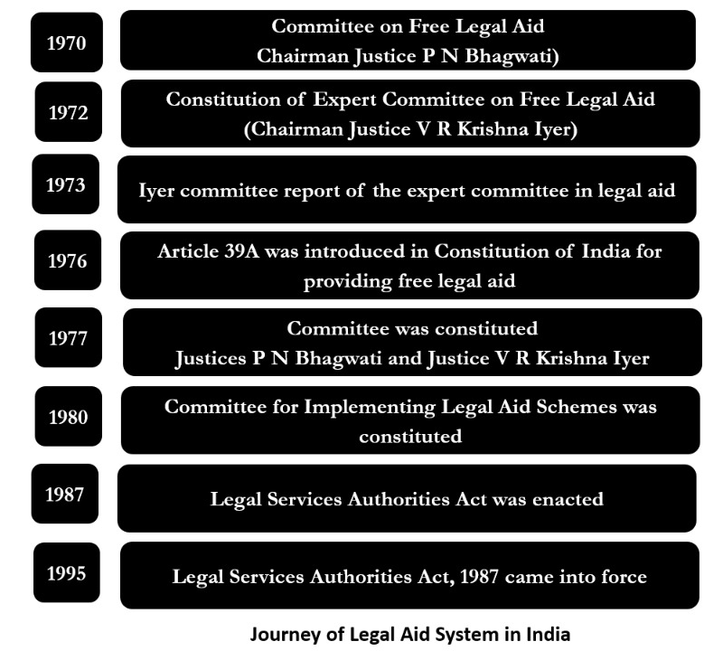

Slide 12
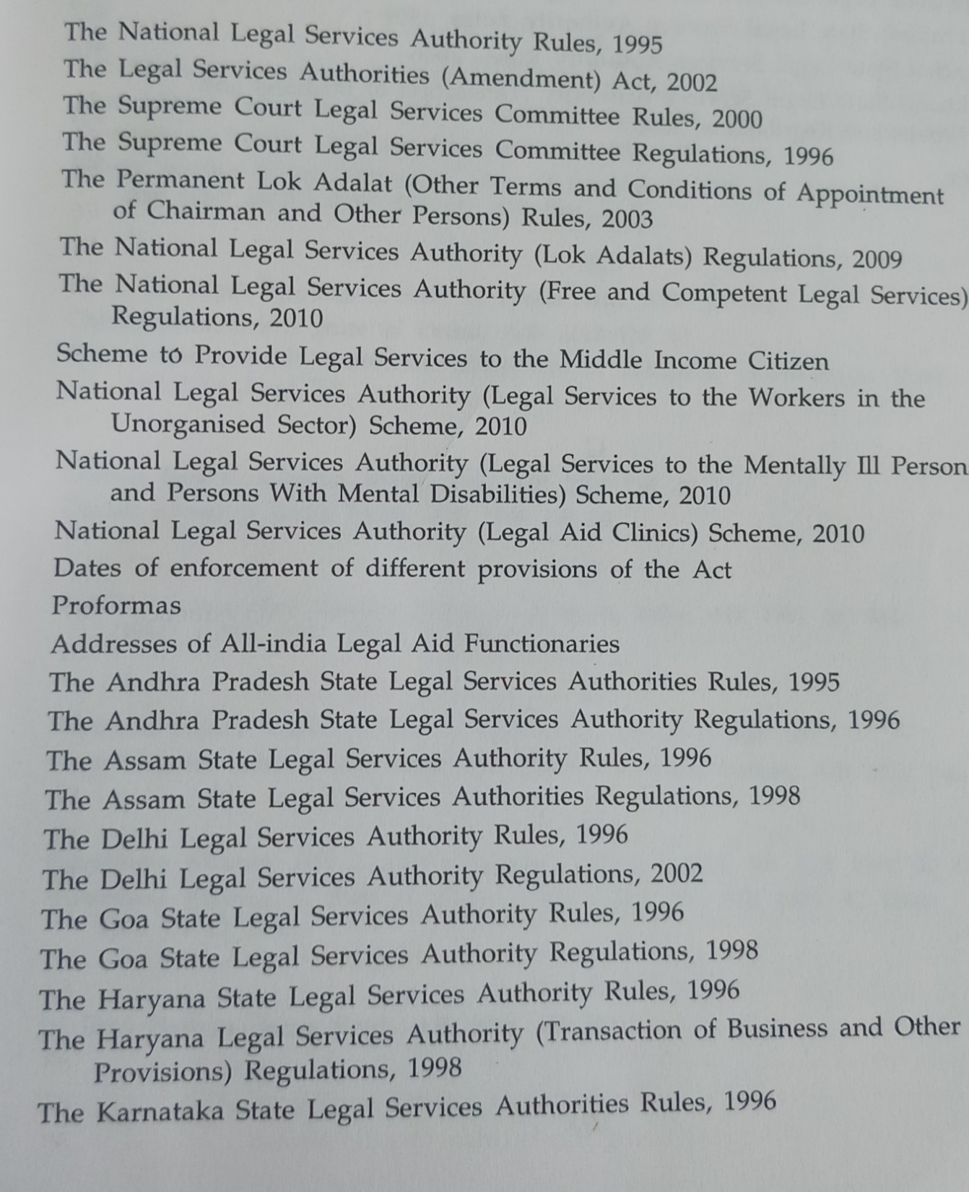
Legal Services Authorities Act, 1987

Slide 13
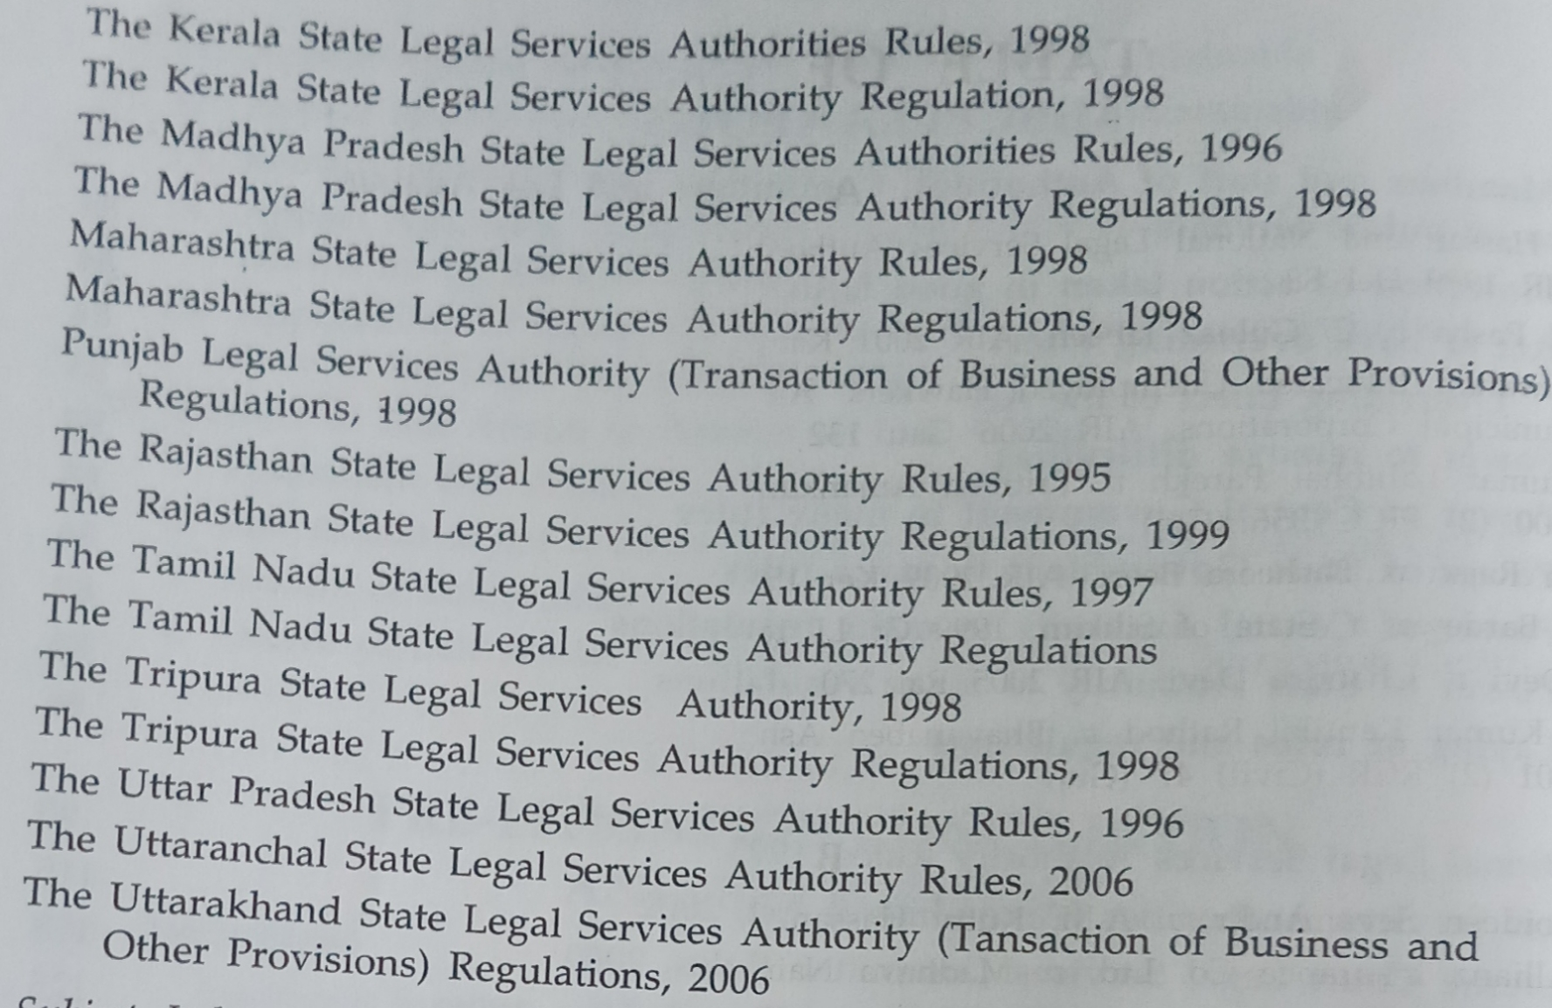
Legal Services Authorities Act, 1987

Slide 14
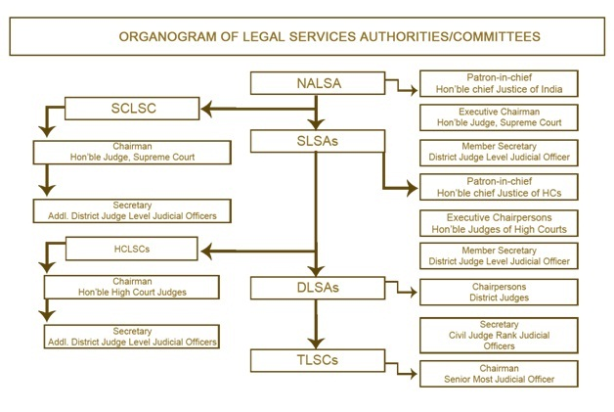

Slide 15
Issues
Lack of Clinical Legal Education
Lack of dedicated legal aid counsels
Budget constraints
No idea about legal aid activities

Slide 16
Case 1

Slide 17
A Study of Law School Based Legal Services Clinics (2011)*
Access to Justice Project on “Study of the Law School based Legal Service Clinics” was undertaken in seven States: Orissa, Bihar, Chhattisgarh, Jharkhand, Uttar Pradesh, Madhya Pradesh, and Rajasthan. Total 39 Law Schools covered.
The study was intended to understand the functioning of legal aid cells established in these states by the law colleges and suggests ways and means to improve their functioning to act as effective instruments of access to justice.
*http://www.in.undp.org/content/india/en/home/library/democratic_governance/a_study_of_law_schoolbasedlegalservicesclinics.html

Slide 18
A Study of Law School Based Legal Services Clinics (2011)*
Findings
82% of the colleges have designated faculty to conduct legal aid activity. But only a miniscule of them provides the facility of academic credit to the faculty in terms of workload/lecture hours and for the students in terms of grades or marks. This has considerably reduced the enthusiasm in the conductance of legal aid activity and many often consider them burdensome or additional work in the process the cause of legal aid is substantially dampened.
Few activities on legal awareness i.e. public talk
Few were having collaboration with NGOs and other local bodies
*http://www.in.undp.org/content/india/en/home/library/democratic_governance/a_study_of_law_schoolbasedlegalservicesclinics.html

Slide 19
A Study of Law School Based Legal Services Clinics (2011)*
Reasons for ineffective work
1. Lack of financial support
2. Restriction on faculty to practice
3. Absence of academic credit for students
4. Legal aid not being part of the work load for faculty
5. Lack of involvement of the bar
6. Lack of infrastructural facilities
7. Lack of involvement of judiciary
8. Restriction on students
9. No training of faculty
10. Lack of directive from BCI
11. Absence of designated full time faculty
12. Poor student quality
13. Lack of trained faculty
14. Part time students
*http://www.in.undp.org/content/india/en/home/library/democratic_governance/a_study_of_law_schoolbasedlegalservicesclinics.html

Slide 20
A Study of Law School Based Legal Services Clinics (2011)*
Few Recommendations for strengthening legal aid centres
1. Faculty designated for Legal Aid need training and the students need to be trained in several skills that are required for organizing legal aid activities. Hence, a Training of Trainers Program (TOT) needs to be organized in each State. These programs need to be designed and conducted by expert faculty in Clinical Methodology. A nodal agency which is actually involved in Legal Aid may be identified for conducting training programs for the faculty of Law Schools in the project States.
2. Identifying 5 potential Law Schools from each State to strengthen their Clinics. Total 35 faculties from the identified Law Schools from seven States should be trained in Legal Aid. Two week intensive training program should be conducted to train these faculty members. These trained faculty members would strengthen the Clinics in their respective Colleges. Within a year, 35 Clinics in seven States would be functional.
*http://www.in.undp.org/content/india/en/home/library/democratic_governance/a_study_of_law_schoolbasedlegalservicesclinics.html

Slide 21
A Study of Law School Based Legal Services Clinics (2011)*
Few Recommendations for strengthening legal aid centres
3. This activity may be continued for five years and within five years there would be at least 25 Law Schools in each State with fully functional Clinics. The nodal agency would be monitoring the progress of the Clinics. A quarterly newsletter showcasing the activities carried by the selected Law School Clinics could be brought out.
4. A proper networking would be developed among these Clinics and at the end of the year a Conference on Legal Aid Clinics should be organized. The purpose of this Conference would be to involve students and faculty with other stake holders on a single platform to share the experiences and best practices among the Law Schools.
5. Identifying expert Clinical faculty to prepare Training Manuals on activities of Legal Aid.
*http://www.in.undp.org/content/india/en/home/library/democratic_governance/a_study_of_law_schoolbasedlegalservicesclinics.html

Slide 22
A Study of Law School Based Legal Services Clinics (2011)*
Few Recommendations for strengthening legal aid centres
6. Continue the same initiation in all other States.
7. Create a website for sharing the concerns and experiences.
*http://www.in.undp.org/content/india/en/home/library/democratic_governance/a_study_of_law_schoolbasedlegalservicesclinics.html

Slide 23
Case 2

Slide 24
Impact of Competency & Commitment of the Legal Aid Counsels of the Legal Aid System in the City of Delhi*
Samples
702 beneficiaries of legal aid services
173 judicial officers
11 member secretaries Delhi Legal Services Authorities
174 Legal Aid Counsels
1039 women at Special Courts and Family courts
*Conducted Empirical Research under the UGC Research Award in 2014 by Prof. Jeet Singh Mann, NLU Delhi

Slide 25
Impact of Competency & Commitment of the Legal Aid Counsels of the Legal Aid System in the City of Delhi*
Findings
98% of the beneficiaries opted for free legal services on the ground that they had no resources to engage paid private counsels for their litigation.
*Conducted Empirical Research under the UGC Research Award in 2014 by Prof. Jeet Singh Mann, NLU Delhi

Slide 26
Impact of Competency & Commitment of the Legal Aid Counsels of the Legal Aid System in the City of Delhi*
Findings
54.5% of the regulators find that the LACs join legal aid services for promoting and supporting the causes of the beneficiaries of the legal aid services.
9.1% regulators felt that LACs join legal aid services for employment opportunities.
Another 36.4% regulators were of the considered views that LACs joins legal aid services to gain experiences in courts. The moment the LACs get some exposure and become confident at practice in courts, they depart from the legal aid institutions. As per the views of those regulators respondents, LACs are allowed to practice and experiment at the cost of poor beneficiaries.
*Conducted Empirical Research under the UGC Research Award in 2014 by Prof. Jeet Singh Mann, NLU Delhi

Slide 27
Impact of Competency & Commitment of the Legal Aid Counsels of the Legal Aid System in the City of Delhi*
Findings
Lack of devotion is probably due to the nature of engagement of the LACs and the better quantum of honorarium involved in their private practice as compared to legal aid services.
It is also seen that the LACs are piece rated employees, although not in strict sense, because they are involved and paid on the basis of allotted cases, where honorarium in stages is paid, without any usual payment like a regular employee. In the real sense, they are not empanelled for the full-time operation of the legal aid services. This can be deducted from the fact that 29.3% LAC respondents are accessible for the free legal aid litigation on a part time basis only.
More than 57.5% of the LACs do not have full time availability, because of ad-hoc empanelment by the DLSA
*Conducted Empirical Research under the UGC Research Award in 2014 by Prof. Jeet Singh Mann, NLU Delhi

Slide 28
Impact of Competency & Commitment of the Legal Aid Counsels of the Legal Aid System in the City of Delhi*
Findings
37% of the beneficiary respondent, the LACs demanded money for providing legal aid services to the beneficiaries.
56.4% beneficiaries either did not pay or were reluctant to disclose.
90.9% of the regulators have acknowledged that complaints from the beneficiaries regarding LACs demanding money for defending the claims of the beneficiaries have regularly been received at the DLSAs
About 2.3% the LACs have accepted that they demanded money from the beneficiaries for the service rendered. As per these respondents, a LAC is required to make initial payment for the relevant documents & charges and the DLSAs make no advance payment at the time of allocation of cases to the LACs. After that, bills and forms submitted to the DLSAs for claiming honorarium in stages.
*Conducted Empirical Research under the UGC Research Award in 2014 by Prof. Jeet Singh Mann, NLU Delhi

Slide 29
Impact of Competency & Commitment of the Legal Aid Counsels of the Legal Aid System in the City of Delhi*
Findings
Parameters – Quality of arguments, quality of articulation and quality of drafting
72.8% regulators who are responsible for the empanelment of the LACs, have assessed that most of the LACs are above average and none below average in their argument skills
55.9% of the judicial officers were of the view that the quality of argument skills of the LACs is below average
21.7% of the respondents in the same category felt that the LACs are just average in their skills
As per 61.8% judicial officer, LACs were of just average in the event of articulation skill. Whereas around 18.5% of the judges have found it to be below average.
54.5% of the regulators are of the opinion that LACs are good at the drafting, another 45.5% felt the drafting skills of the LACs are just fair or average.
*Conducted Empirical Research under the UGC Research Award in 2014 by Prof. Jeet Singh Mann, NLU Delhi

Slide 30
Impact of Competency & Commitment of the Legal Aid Counsels of the Legal Aid System in the City of Delhi*
Findings
Around 49.7% of the judicial officers and 54.5% regulators indicate that majority of the LACs are of average professional skills.
Around 26.1% judicial officers were of the considered appraisal that overall professional skills of the LACs are below satisfaction level.
Assessment of the find that LACs were not competent to handle serious crimes involving a matter of life and death. As per the considerate views of 89.30% of the judicial officers, the LACs are never engaged in serious crimes such as rape, murder, culpable homicide not amounting to murder, narcotics and other major offences.
Such senior judicial officers always consider the appointment of amicus curiae, generally experienced legal practitioners of competency known to the judicial officers, are engaged to protect the interest of poor people, who are not in a position to hire a counsel at own.
*Conducted Empirical Research under the UGC Research Award in 2014 by Prof. Jeet Singh Mann, NLU Delhi

Slide 31
Impact of Competency & Commitment of the Legal Aid Counsels of the Legal Aid System in the City of Delhi*
Findings
As per opinion of 61.8% judicial officers, the LACs are just average in case of arguments skills.
75.1% judicial officer opined that the LACs are partly committed to the causes of legal aid services. These judicial officers found that majority of the LACs are occupied with a private practice and hardly interested in the protection of the interests of the beneficiaries.
37.3% of the beneficiary expressed that LACs are not devoted the services of legal aid system. Another 18.5% beneficiaries considered that LACs were not at all committed.
Overall aspects, 69.5% of the respondents, infers that LACs are not entirely committed and devoted to the causes of beneficiaries.
*Conducted Empirical Research under the UGC Research Award in 2014 by Prof. Jeet Singh Mann, NLU Delhi

Slide 32
Impact of Competency & Commitment of the Legal Aid Counsels of the Legal Aid System in the City of Delhi*
Findings
95% of the women respondent at family courts and special courts because of low commitment and competency of the LACs preferred paid service of private legal practitioners over free legal aid services of legal aid counsels in Delhi.
*Conducted Empirical Research under the UGC Research Award in 2014 by Prof. Jeet Singh Mann, NLU Delhi

Slide 33
Impact of Competency & Commitment of the Legal Aid Counsels of the Legal Aid System in the City of Delhi*
Findings
Monitoring Committee hardly created by legal services authorities in 11 courts in Delhi
*Conducted Empirical Research under the UGC Research Award in 2014 by Prof. Jeet Singh Mann, NLU Delhi

Slide 34
Impact of Competency & Commitment of the Legal Aid Counsels of the Legal Aid System in the City of Delhi*
Findings
Around 20.2% judicial officers were also of the opinion that lack of accountability of the LACs is one of main reasons for the dilapidated state of affairs of the commitments of the LACs.
The DSLSA or the Bar Council of Delhi or Bar Council of India has hardly punished any LAC proportionately for demanding money from beneficiaries, which is grave misconduct on the part of any legal practitioners.
Further, the LACs may resign or refuse to entertain the allotted case or withdraw at any point in time from the list of empanelment.
*Conducted Empirical Research under the UGC Research Award in 2014 by Prof. Jeet Singh Mann, NLU Delhi

Slide 35
Impact of Competency & Commitment of the Legal Aid Counsels of the Legal Aid System in the City of Delhi*
Recommendations
Creation of full time monitoring committee.
Rigorous empanelment process and incentivisation.
Introduction of a system of feedbacks to assess the commitment and competency of the LACs.
Punishment for the premature withdrawal or rejection for the legal aid services.
Maintenance of records.
Code of Professional Conducts for the LACs.
Recognition of the services of the LACs for the appointments and other benefits.
Creation of full time empanelment on tenure basis of the LACs.
*Conducted Empirical Research under the UGC Research Award in 2014 by Prof. Jeet Singh Mann, NLU Delhi

Slide 36
Case 3

Slide 37
State of Gujarat v/s. Manjuben (Guj HC, 18/03/2019)
Cross Examination Is Not Child's Play, Purpose of Legal Aid Is Not to Provide Platform for Young Lawyers: Gujarat HC*
Legal aid is a farce: Gujarat HC**
Without mincing words, the Gujarat High Court has termed the system of providing legal aid to the poor litigants as 'a farce.' This harsh observation was made by the division bench comprising Justice J B Pardiwala and Justice A C Rao in a judgement setting aside the death penalty awarded to a woman for double murder.
The court noted that it was on account of poverty and being a helpless girl just 19 years of age that accused could not engage a seasoned, well- experienced lawyer for trial and instead had to depend on a junior lawyer who was not sufficiently experienced to conduct a trial.
*https://www.livelaw.in/news-updates/purpose-of-legal-aid-is-not-to-provide-platform-for-young-lawyers-143676?fbclid=IwAR001hHDVXhP5_vjvLJdoi9VdVwD8jiQGp_O0VLuC8krqcwZ3SvCYIoH_Rs
**https://www.thehansindia.com/news/national/legal-aid-is-a-farce-gujarat-hc--515010?fbclid=IwAR0RP9VIMW6sHuUmaMmnIJQTl4UwJrbAXjyCT3V27pG1P83CjwgXRJ4E5UQ

Slide 38
The Way Forward
More emphasis on clinical legal education
Dedicated legal aid counsels to be deployed by legal service authorities
Definition of legal aid to be expanded in Legal Service Authority
Scope of Legal Aid to be expanded
Coordination between law colleges, ngos, civil societies
Innovation in legal aid activities

Slide 39
The Way Forward
Innovation in legal aid activities
HOW ?

Slide 40
Legal Startups

Slide 41
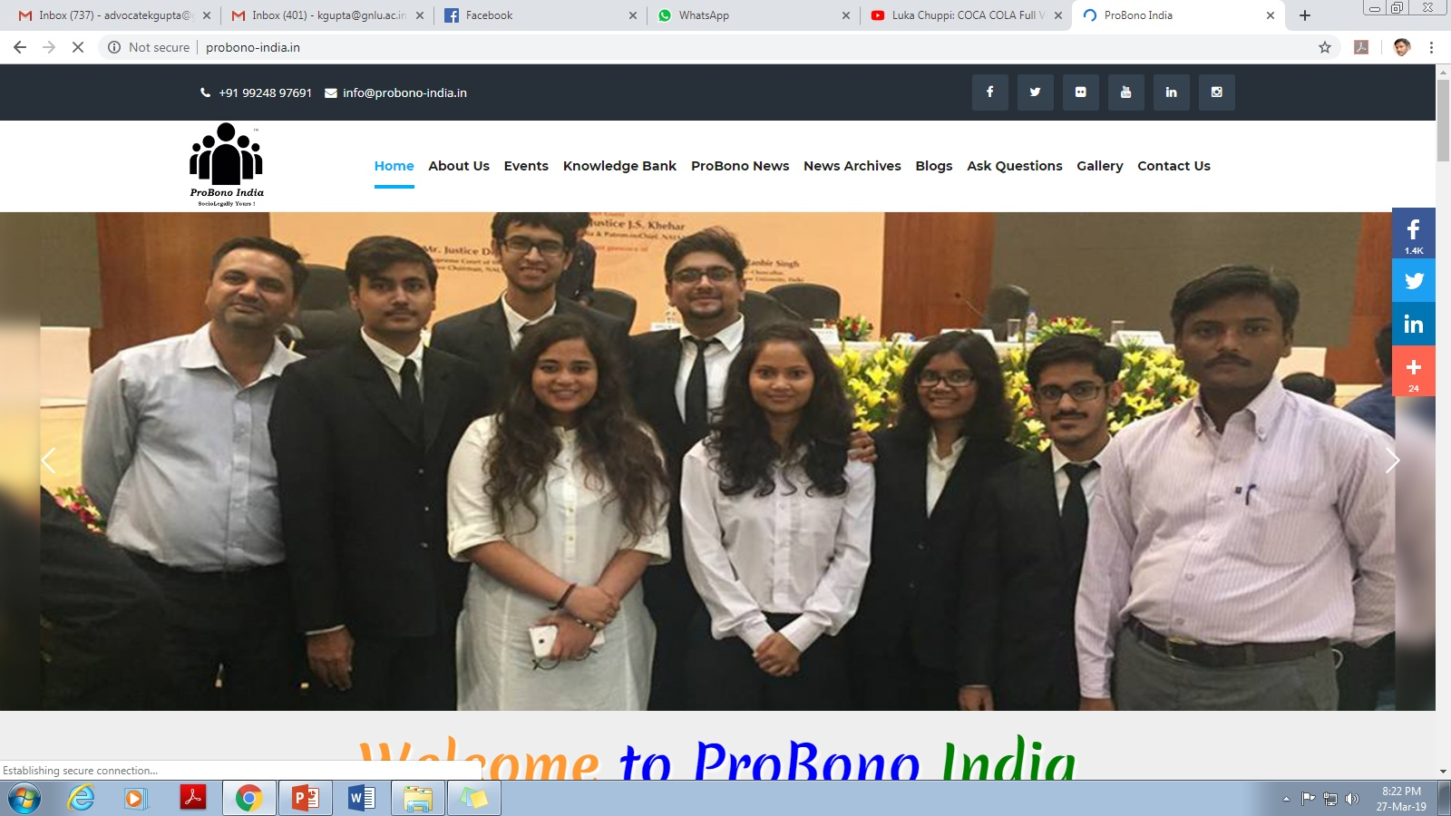
http://probono-india.in/

Slide 42
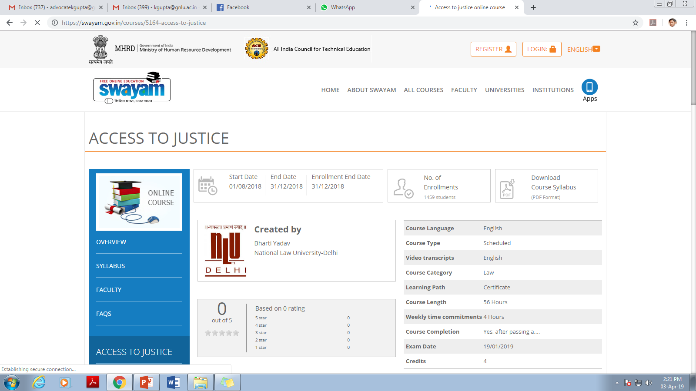

Slide 43
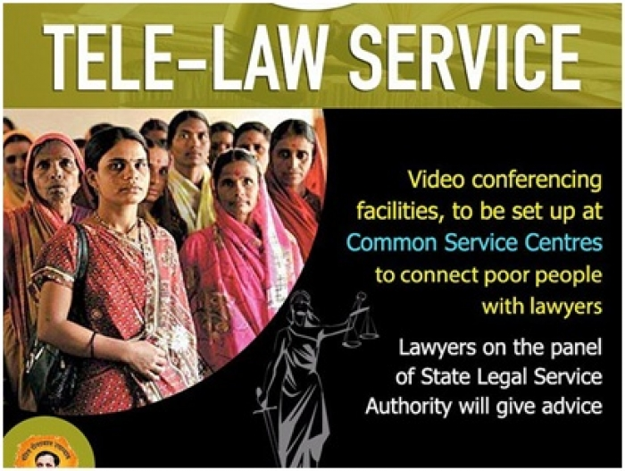
http://www.tele-law.in/
Launched in April 20, 2017

Slide 45
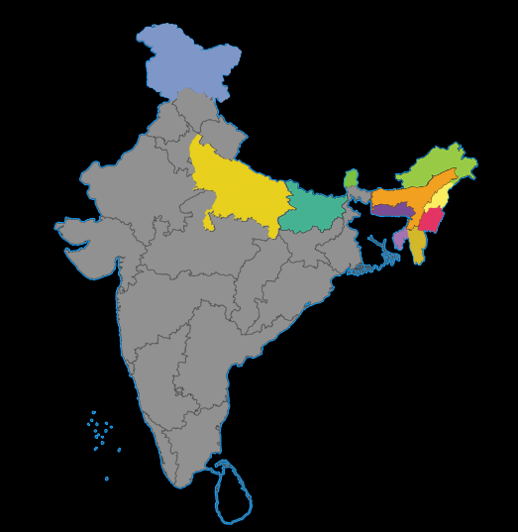
S.No States No. of CSCs
1 Assam 450
2 Arunachal Pradesh 29
3 Bihar 500
4 Jammu & Kashmir 150
5 Meghalaya 42
6 Manipur 19
7 Mizoram 12
8 Nagaland 48
9 Sikkim 10
10 Tripura 40
11 Uttar Pradesh 500
Total 1800

Slide 46
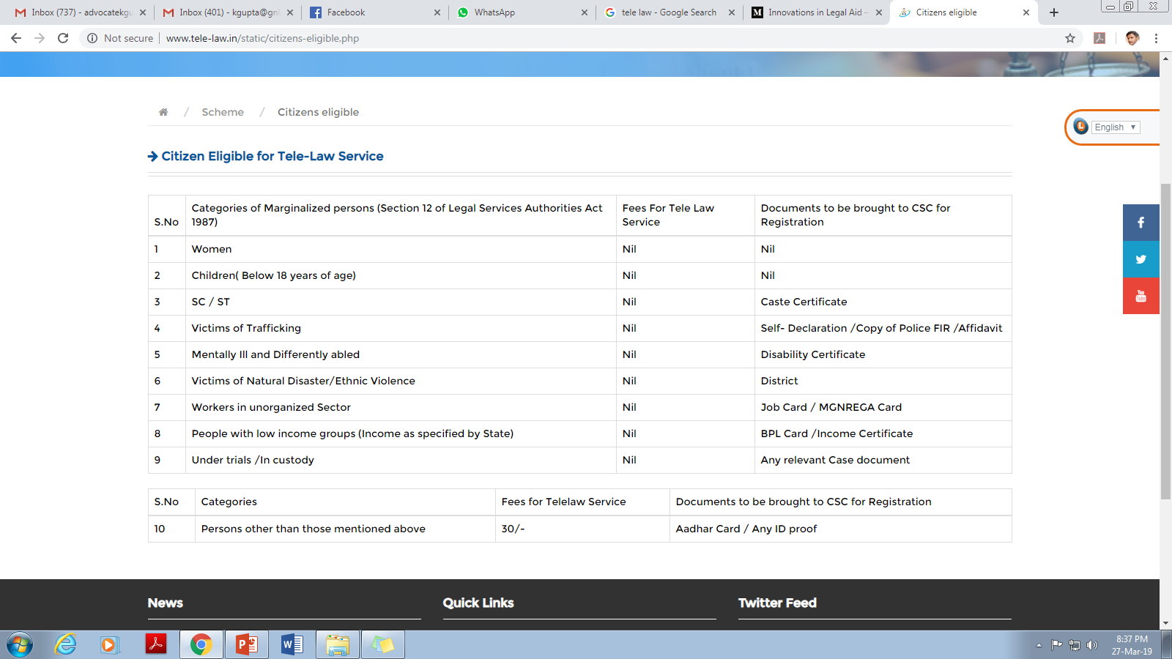

Slide 48
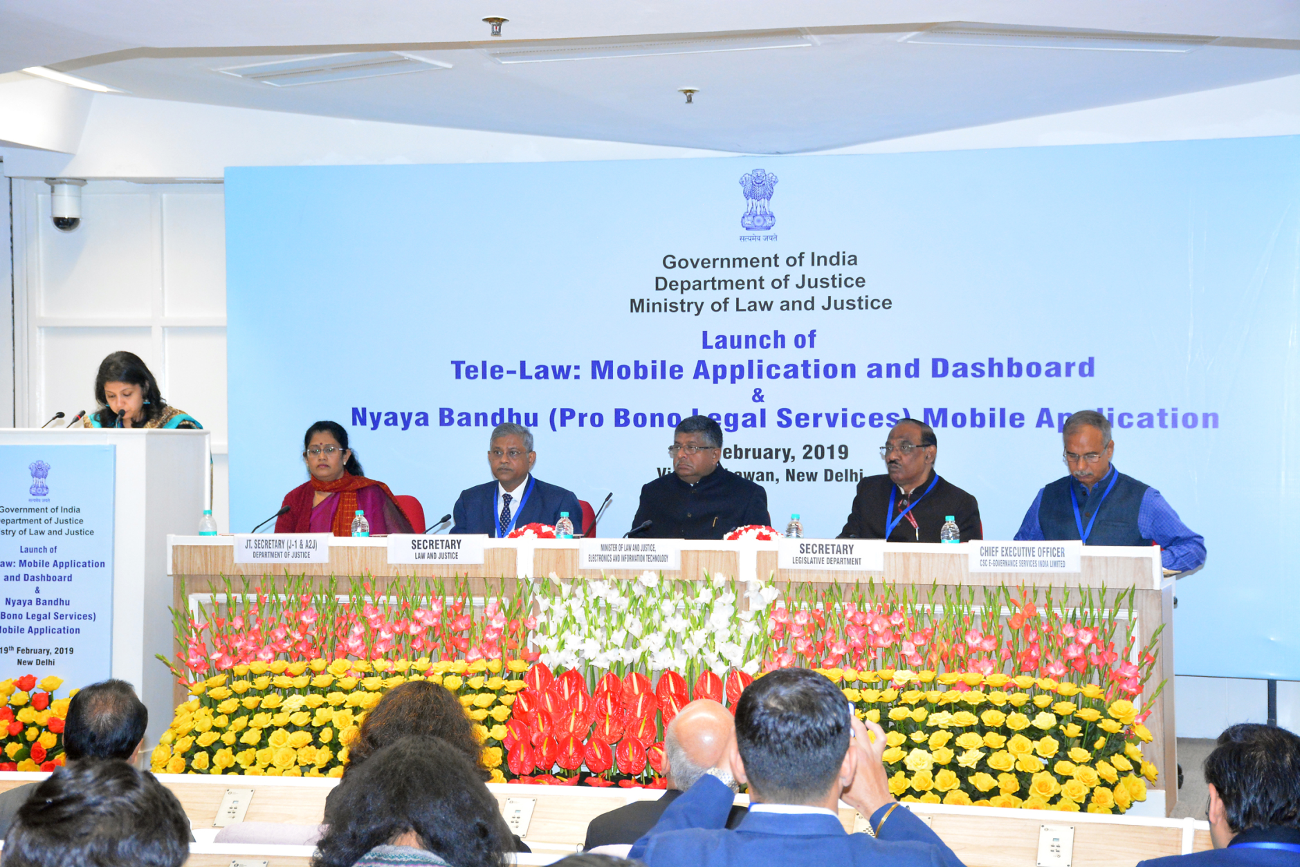

Slide 49
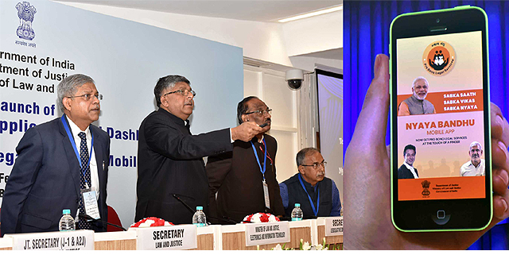
Launched in February 19, 2019
This mobile application will enable the PLVs to perform on field pre – registration of cases with a facility to seek appointment from the Panel lawyer on preferred date and time, in coordination with Village Level entrepreneur (VLE) at the CSC. The application will benefit 73,000 PLVs of National Legal Service Authority and State Legal Services Authorities (SLSA) in the country who will be associated under Tele-Law service.

Slide 50
http://www.probono-doj.in

Slide 51
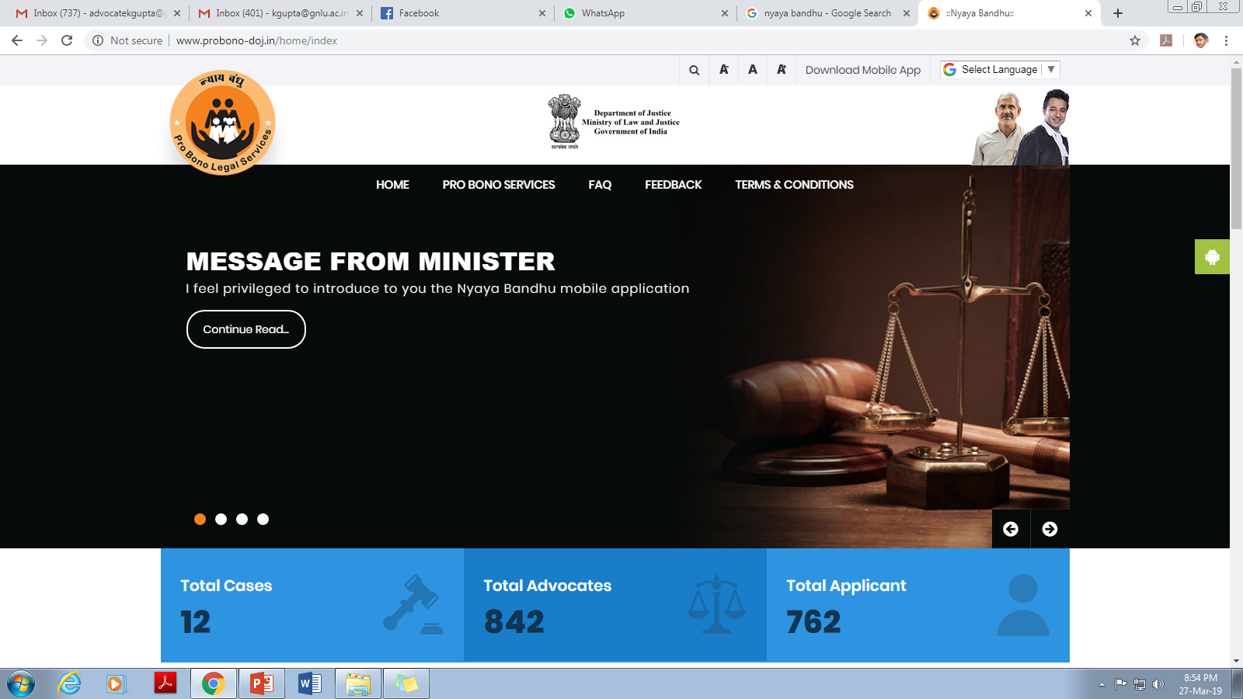
http://www.probono-doj.in

